Slide 1

Flood & Cyclone Early Warning System
A web-based system for real-time alerts and centralized disaster information.

Slide 2

Team Members
Hasibul Islam Hemel
0432310005101005
Azher Mahmud Fahim
0432310005101028
Arafat Al Sani
0432310005101049
Md. Shoyaif Rahman
0432310005101050

Slide 3

Our Purpose
Life Safety
Give people enough time to evacuate and move to safe places.
Property Protection
To help minimize damage to infrastructure, homes, and assets by giving communities sufficient time to secure their properties and take protective measures.
Preparedness
Help communities and authorities get ready with shelters, relief, and emergency services.
Timely Information
To deliver accurate and immediate alerts regarding impending floods and cyclones, ensuring that all stakeholders have the necessary data for swift decision-making.

Slide 4
Features
Real-time Alerts
Based on meteorological data.
Web-based Accessibility
Easy access for all users.
Critical Notifications
Including safety instructions.
SMS Alert System
Instant alerts via text message.

Slide 5

System Features: Priority
The Flood & Cyclone Early Warning System maintains real-time information on weather data (from NASA datasets), alerts, and user notifications.
High Priority: Timely and accurate alerts are critical to saving lives and preventing disaster-related damage in affected regions.

Slide 6
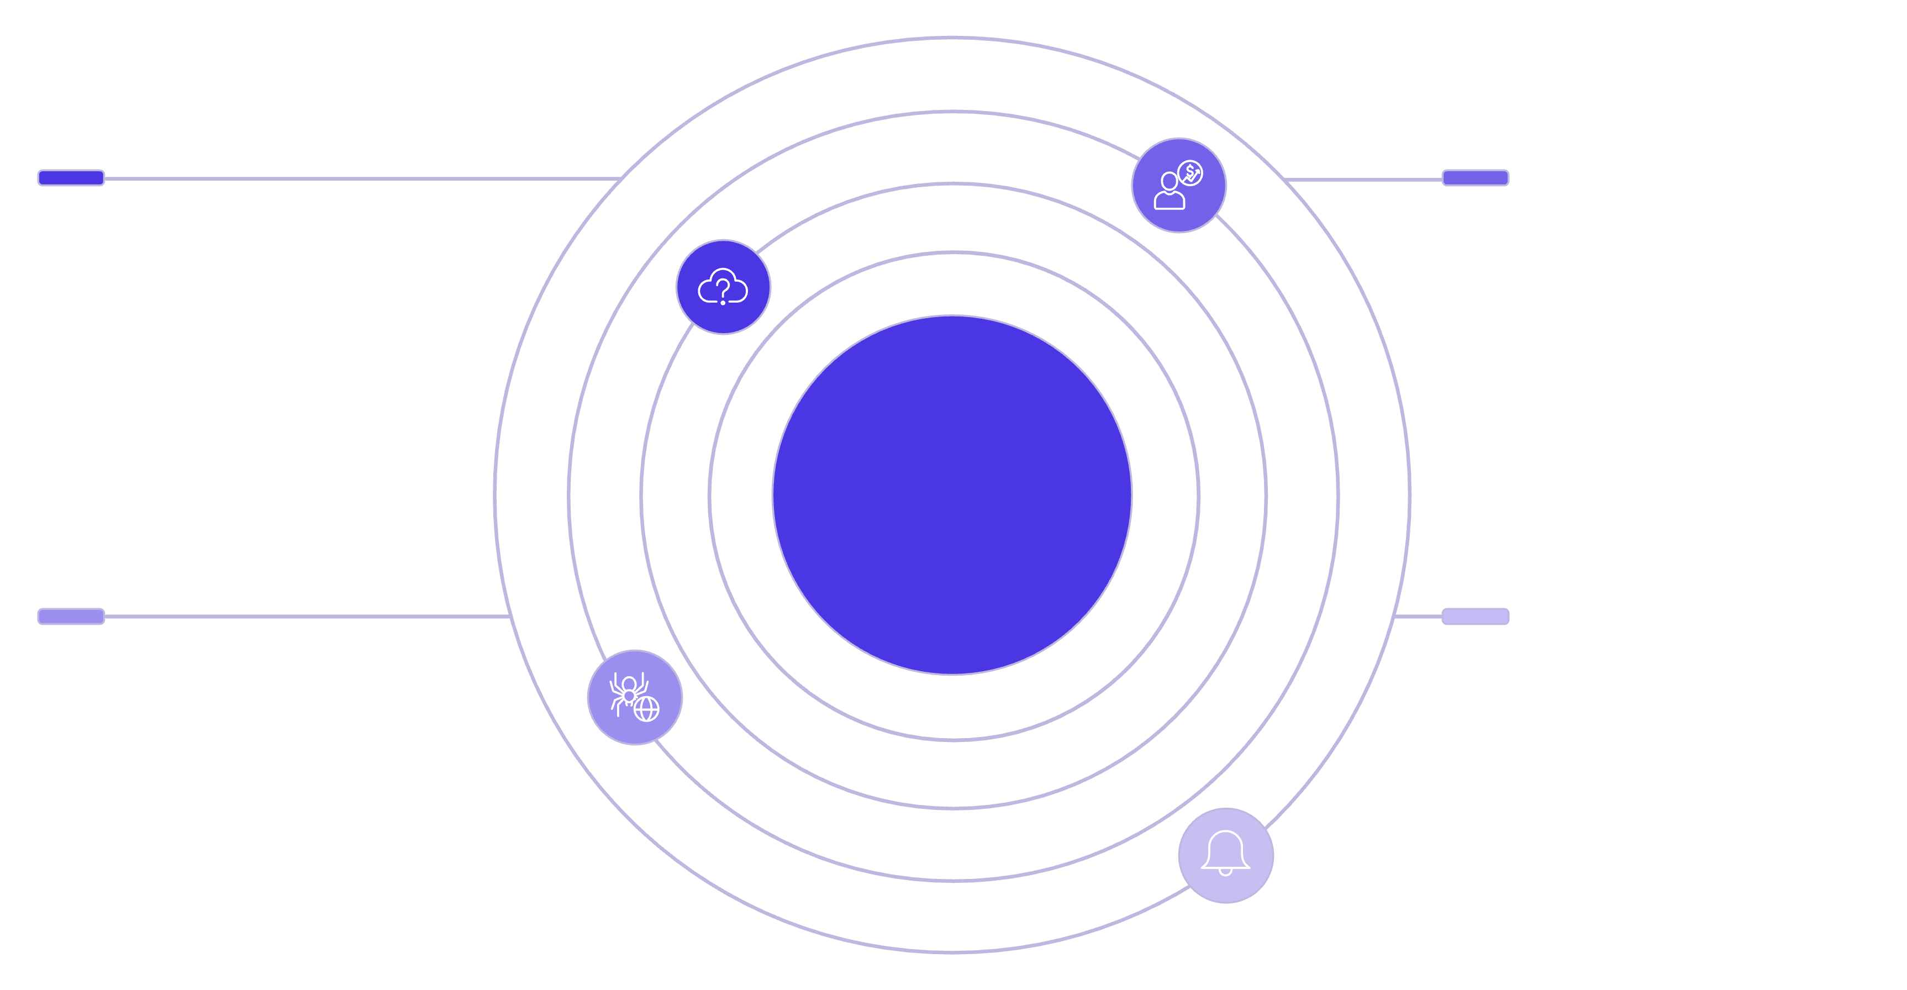




System Overview
Data Integration
Processing
Real-time weather data ingestion and APIs
Data analysis, forecasting, and alert criteria
Flood & Cyclone Early Warning System
Platform
Alert Delivery
Web application built with the MERN stack
Centralized notifications and user alerts

Slide 7



User Roles
Citizens
Authorities
Admins
Receive alerts, view weather data, subscribe to notifications, access safety guidelines.
Monitor live data, track notification status, generate disaster reports, and access all citizen functions.
Manage locations, data sources, alert thresholds, users, and system configurations.

Slide 8
Operating Environment
System Architecture
Database
Client/Server System
MongoDB (NoSQL, distributed)
Distributed Database
Platform
Operating System
MERN Stack (MongoDB, Express.js, React.js, Node.js)
Cross-Platform (Windows / Linux / macOS)

Slide 9

Thank You

